Slide 1
Show how to implement a queue using two stacks
Sebe Msomi 216028604
Moipone Kabai 215203569

Slide 2
Introduction to the problem
The given problem is to show how to implement a queue using two stacks. The queue uses first in, first out method and stack uses last in first out method. We will have two stacks.

Slide 3
Algorithm
We will have two stacks namely stack1 and stack2.
We will use the isEmpty method to check whether Stack1 or stack 2 are empty
Boolean isEmpthy(){
Return stack1 && stack2;
} //return true if both stacks are empty

Slide 4
If stack1 is empty, insert elements into stack 1 and display all the element inserted
void enqueue(element e){
stack1.push(e)
print(stack1)
}
void dequeue(){
If stack1 and stack2 are empty, throw an exception, else display all elements
If(stack1.isEmpty() && stack2.isEmpty()) throw exception(“The stack is empty”)
If(stack2.isEmpty()){
While(!stack1.isEmpty()){
Stack2.push(stack1. pop())
print(stack1)
}//endWhile
}//endIF
Return stack2.pop();
}

Slide 5
void front(){
If(stack2.isEmpty()){
While(!stack1.isEmpty()){
Stack2.push(stack1.pop())
print(stack1)
}//endWhile
}//endIF
Return stack2.peek();
}
Int size(){
Return stack1.size() + stack2.size()
}

Slide 6
Reflection
I learned how to implement a queue using two stacks, I learned that when both stack1 and stack2 are empty that means the stack is empty. I learned that the queue has a first in first out characteristic while stack has last in first out characteristic. I learned that if stack1 is empty, you must insert elements the push them to stack2 while calling the pop method as well. I learned how to implement all the queue methods and the stack methods.

Slide 7
the program will run when successfully when you have both stacks. If stacks are empty it will display a banner message. in order to run the program, you must run the main class that has main method.

Slide 8
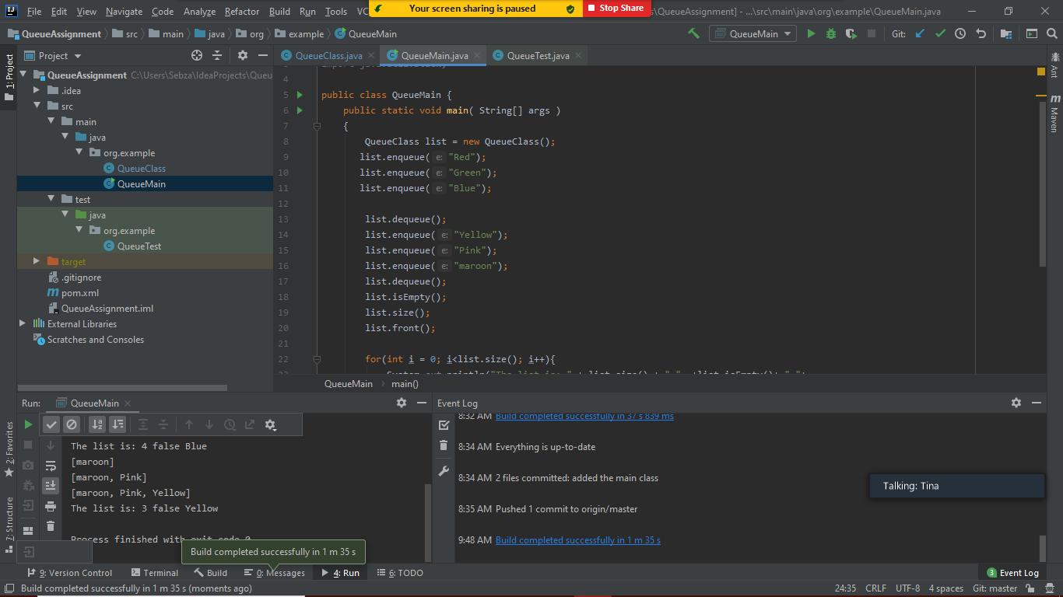

Slide 9
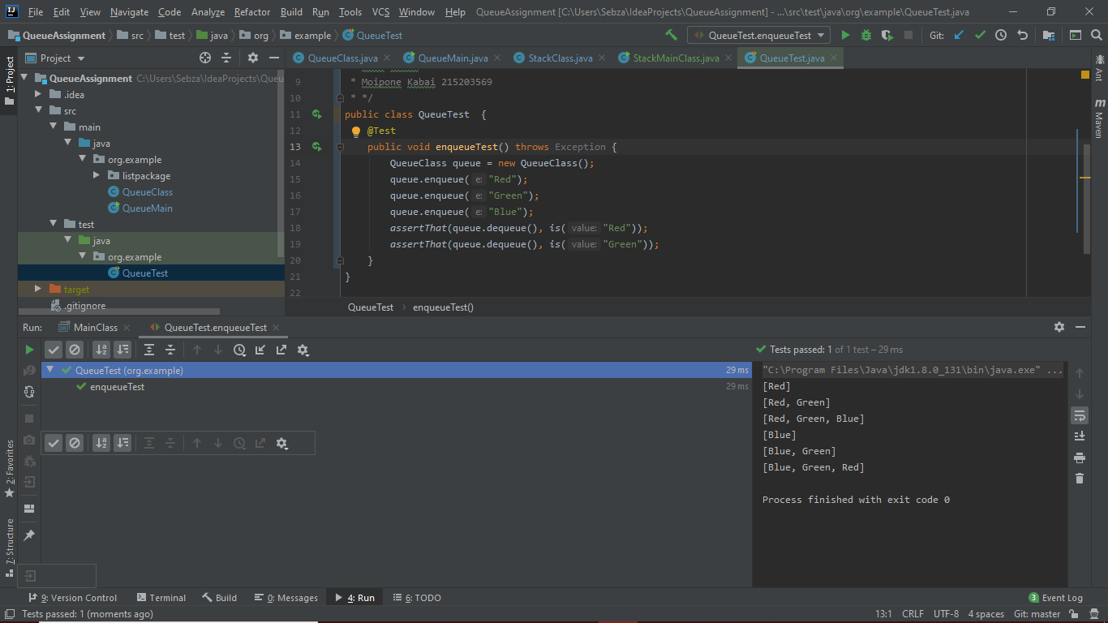
Test case

